Slide 1
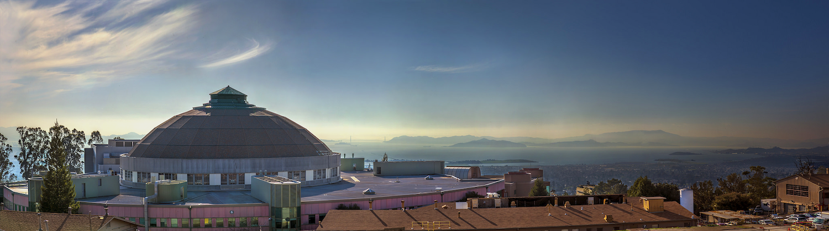



Introduction to SHADOW and ShadowOui
Manuel Sanchez del Rio
srio@lbl.gov

Slide 2
Outlook
History What you must know of SHADOW and ShadowOui does not do it for you Exercises
Sources: Geometrical, Undulator Gaussian, Undulator Full Mirror systems and aberrations Crystal monochromators Lenses Complete Beamline ISN

Slide 3
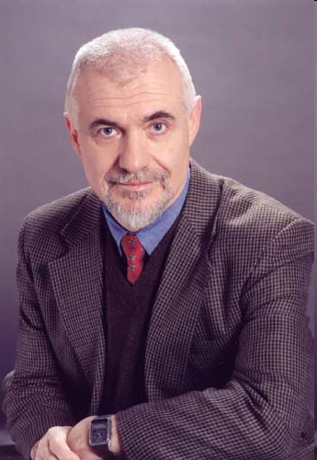
Birth of SHADOW (~1980)
Scientific motivation: Grating monochromator design, TGM, ERG, toridal, spherical mirrors.
Monte Carlo ray tracing program designed to simulate X-ray optical systems
Requirements
Accuracy and reliability
Easy to use
Flexibility
Economy of computer resources
VAX-11 Computers
Efficient MC approach
Reduced number of rays
Exact simulation os SR sources
Vector calculus
Modular
User-interface
Available to users
Two years development
Fortran 77+VAX/VMS extensions

Slide 4
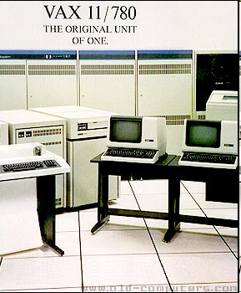
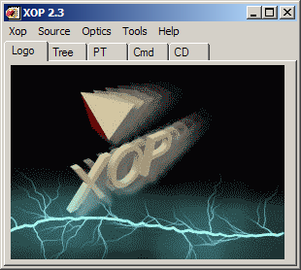
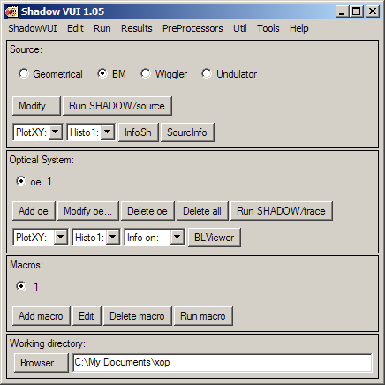
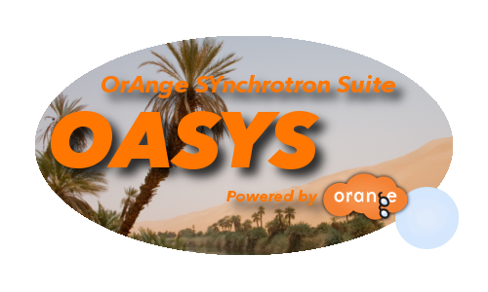
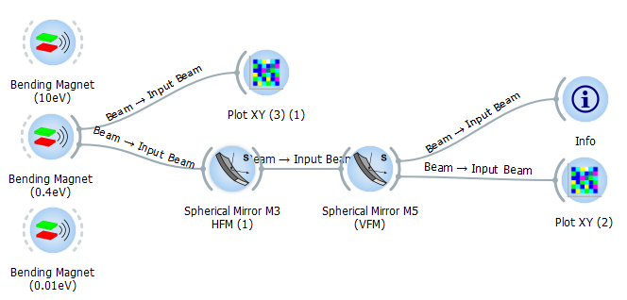
Shadow 1 VAX-VMS 1980-1990 Shadow 2 1990 Unix workstations XOP interface Shadow 3 2010 F90+Python binding 2014 Orange interface: Oasys Shadow 4 2020? Full python version Exploit Oasys framework

Slide 5
OrAnge SYnchrotron Suite (OASYS)
https://www.aps.anl.gov/Science/Scientific-Software/OASYS
ShadowOui
XOPpy
SRW
WOFRY
COMSYL
shadow3
xraylib
srwlib
wofry
comsyl

Slide 6
Ray tracing

Slide 7
Trace (the beamline)
z
Energy, Intensity
y
x
z
y
z
p
q
x
y
x

Slide 8
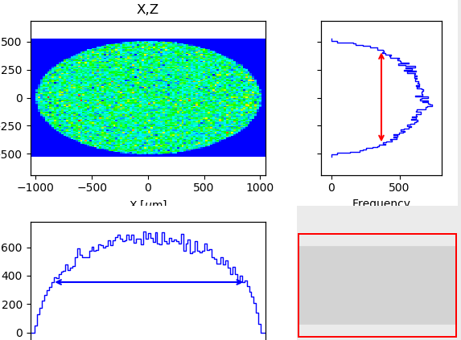
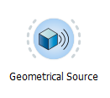
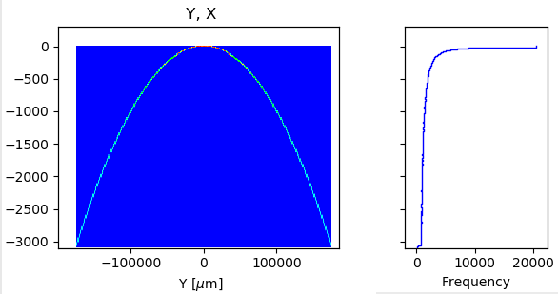
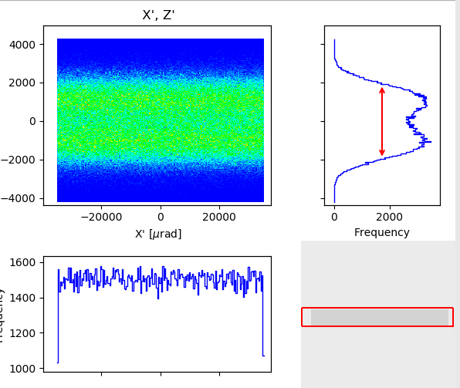
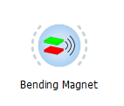
ShadowOUI Sources I

Slide 9
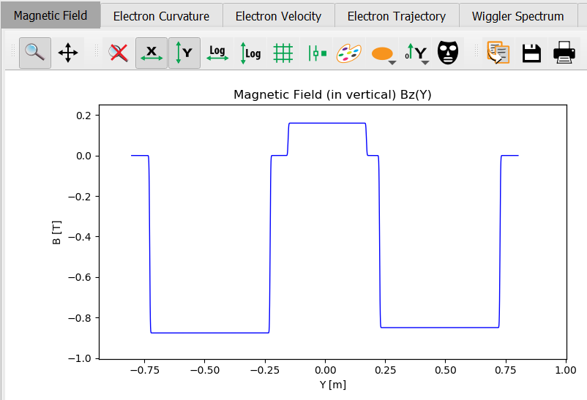
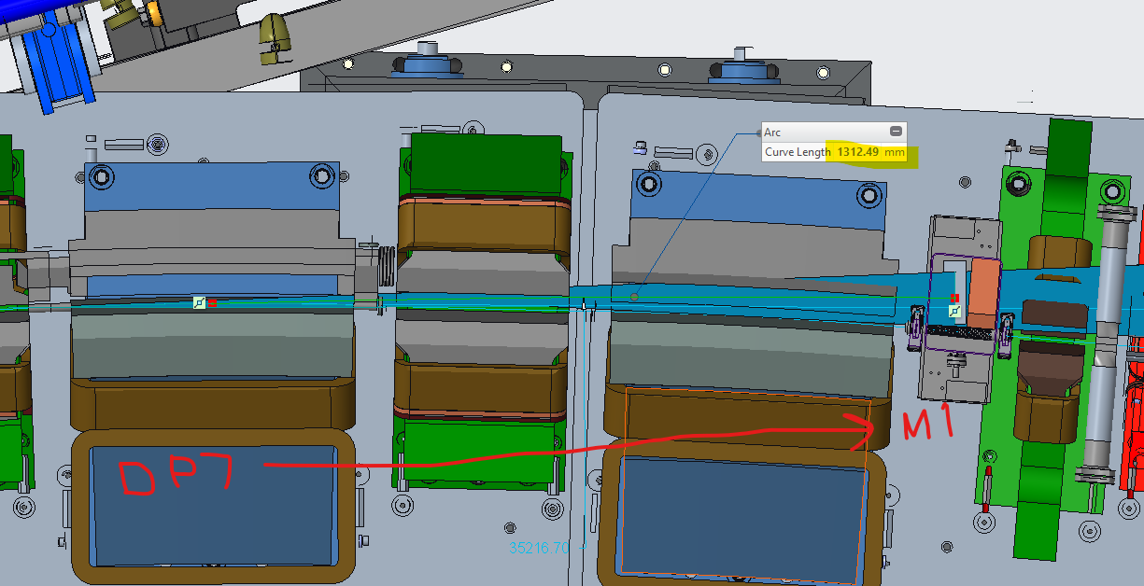
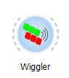
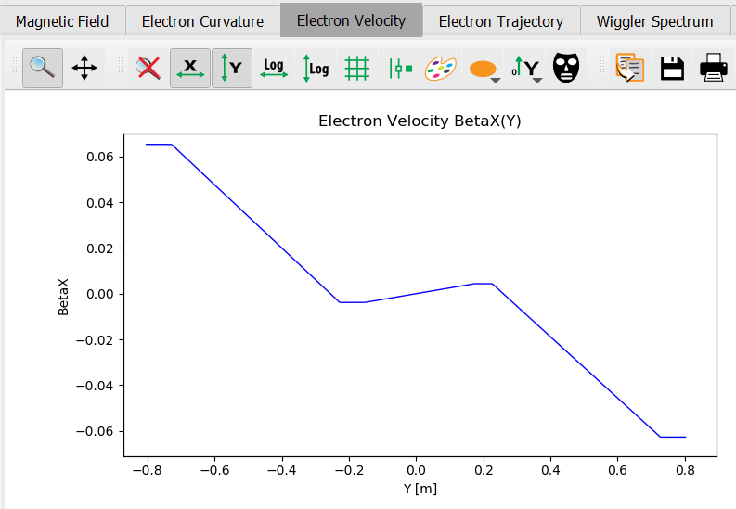
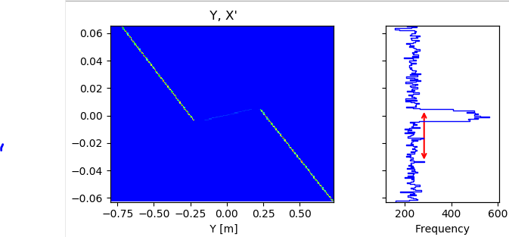
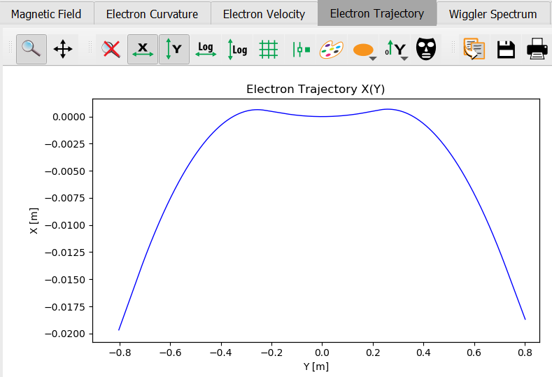
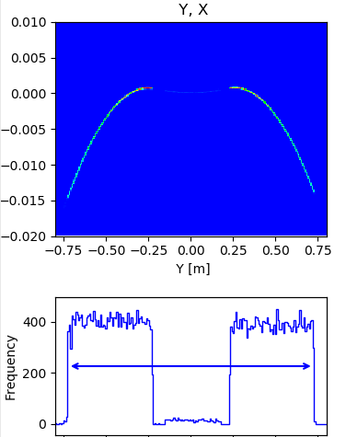
Sources II (Wiggler)

Slide 10
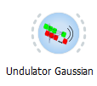
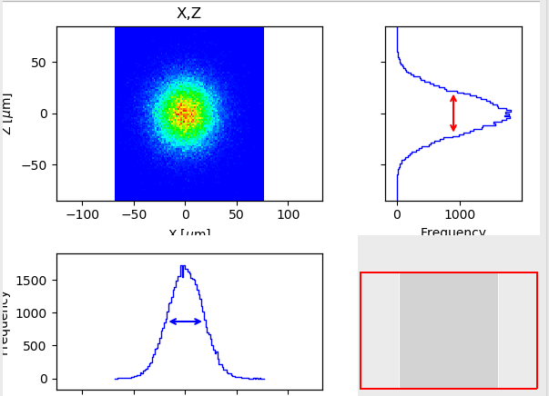
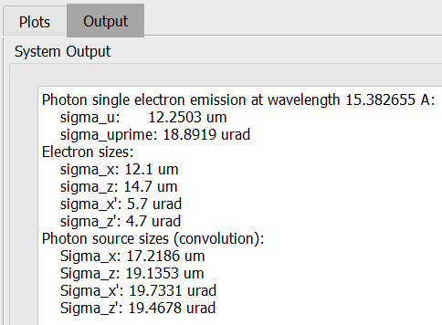
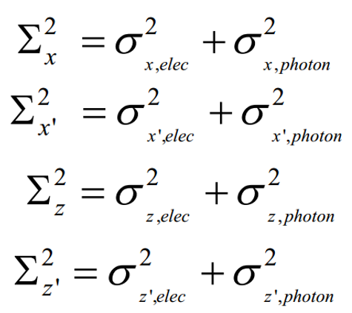
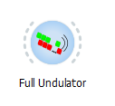
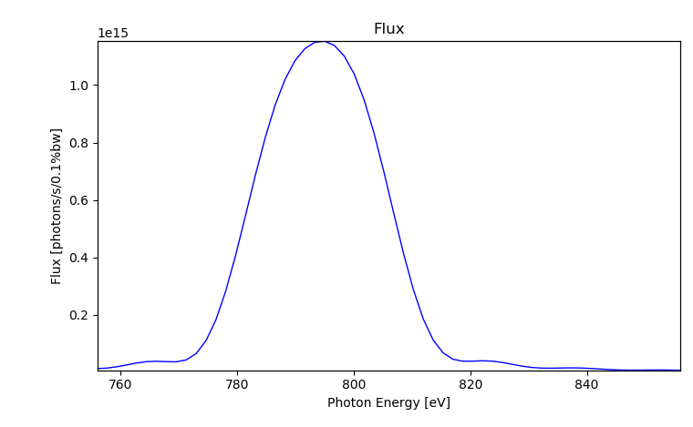
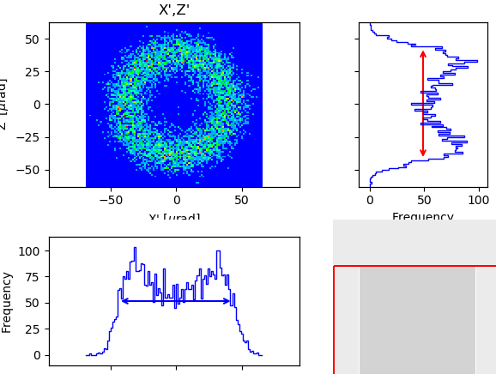
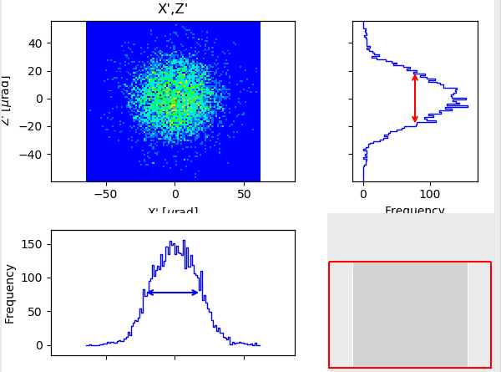
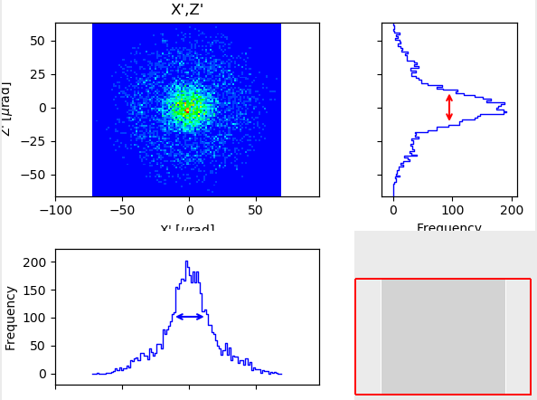
Sources III (Undulator)
Fake Geometrical Source
(Gaussian spatial + Gaussian divergency)
Single e⁻
Photon source:
Divergence:
Size:
Full Undulator
789.938eV
806.060eV
814.121eV

Slide 11
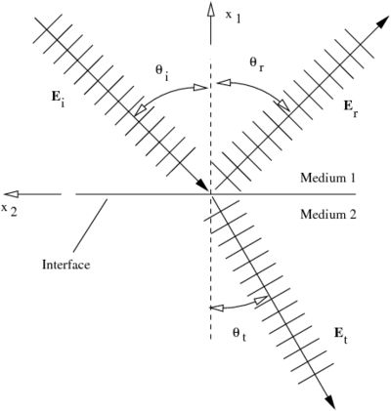
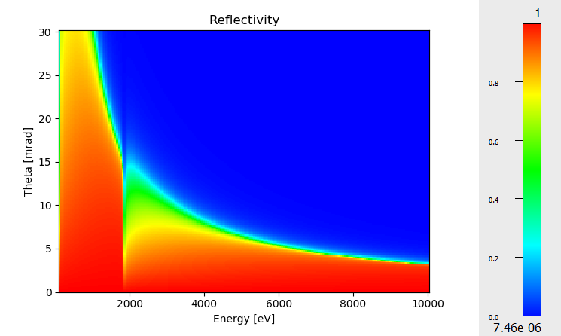
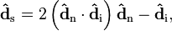
Optical Elements (mirrors) Geometrical model Physical model
Fresnel equations give the reflectivity as a function of angle and photon energy. As a consequence, one gets the critical angle:
Si σ-reflectivity

Slide 12
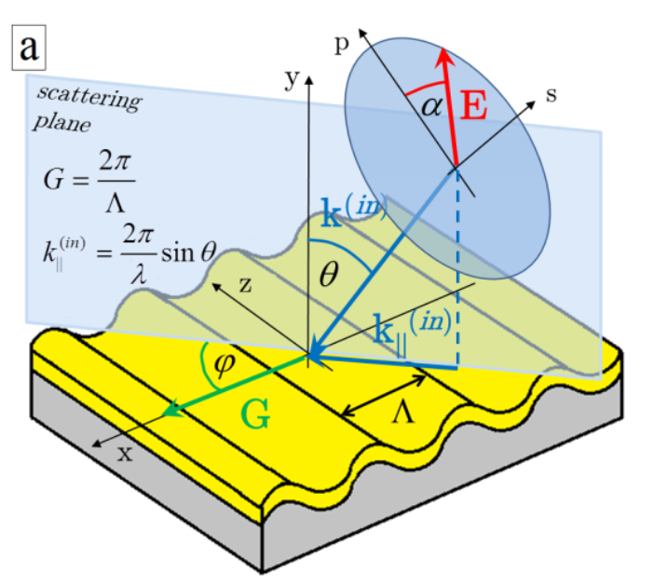
Optical Elements (gratings)
Geometrical model Physical model
No model (yet) in SHADOW for grating efficiency
SHADOW uses Fresnel equations like for mirrors
Figure from doi.org/10.5772/51044

Slide 13
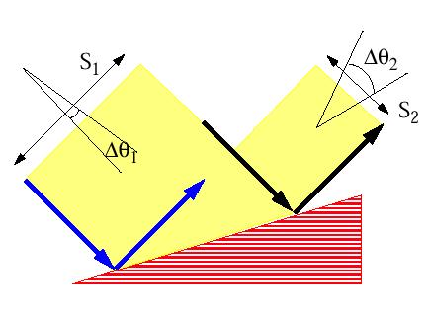
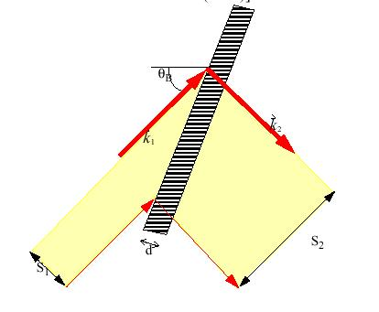
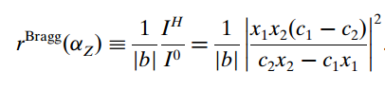
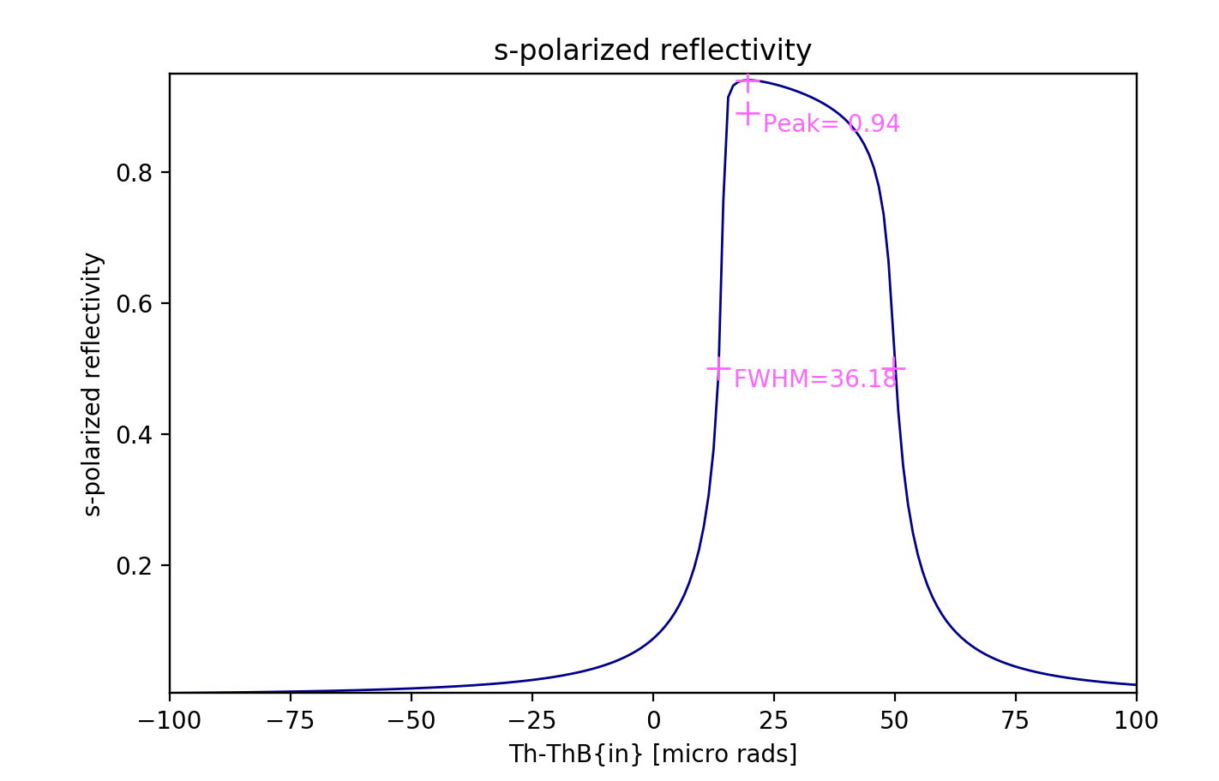
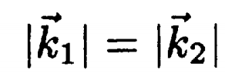
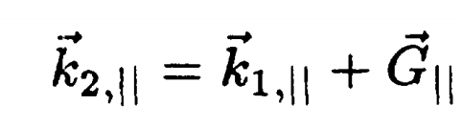
Optical Elements (crystals)
Geometrical model Physical model

Slide 14
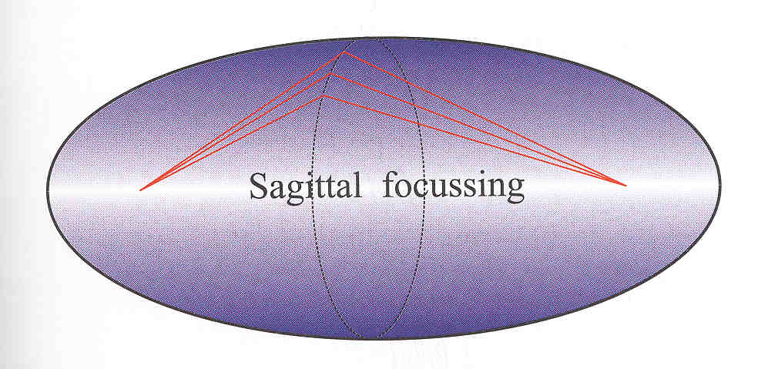
Mirrors and aberrations
R
Ellipsoid: Point to point focusing
Paraboloid: Collimating
Focalization in two planes
Tangential or Meridional (ellipse or parabola)
Sagittal (circle)
Demagnification: M=p/q
Easier manufacturing:
2D: Ellipsoid => Toroid
Only one plane: cylinder Ellipsoid (ellipse)=> cylinder (circle)
Sagittal radius: non-linear (ellipsoid) => constant (cylinder) or linear (cone),
All mirrors produce aberrations
p
q
ρ

Slide 15
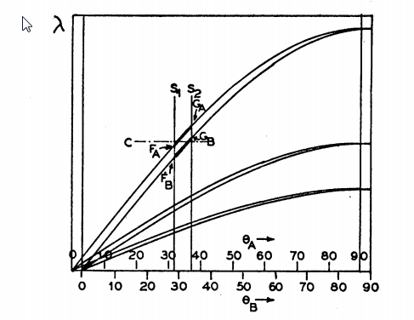
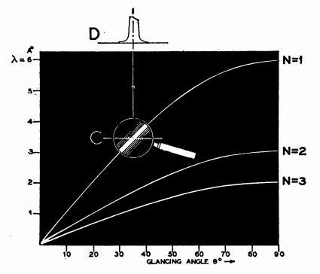
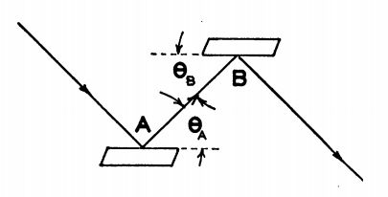
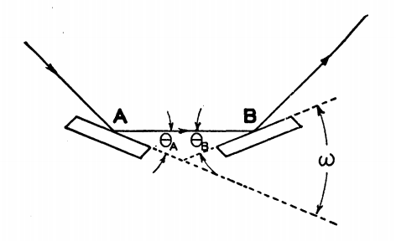
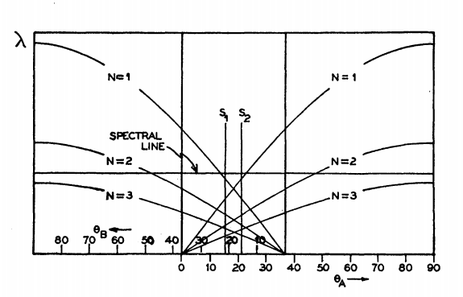
Crystal monochromators
ex17_crystalmono.ows
Theory of the Use of More Than Two Successive X-Ray Crystal Reflections to Obtain Increased Resolving Power J W. M. DuMond Phys. Rev. 52, 872 – (1937) http://dx.doi.org/10.1103/PhysRev.52.872

Slide 16
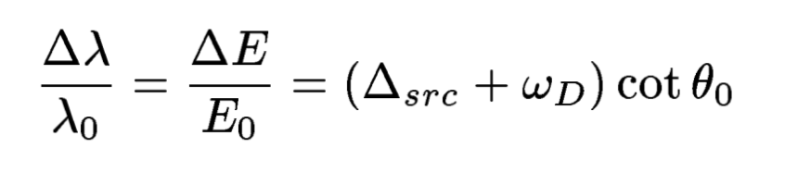
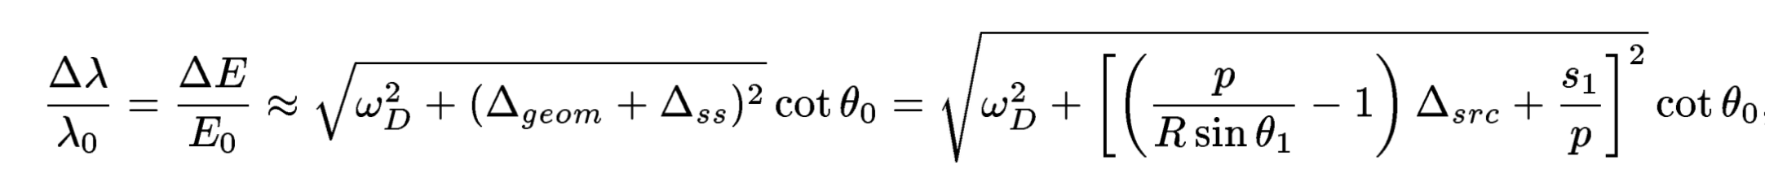
Crystal curvature and spectral resolution
Zero for Rowland mounting:
p = R sin(θ) that for Bragg
symmetric reflection means
1:1 magnification

Slide 17
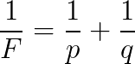
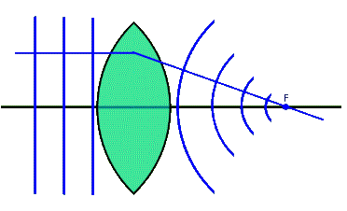
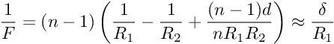
X-ray Lenses
p
q

Slide 18
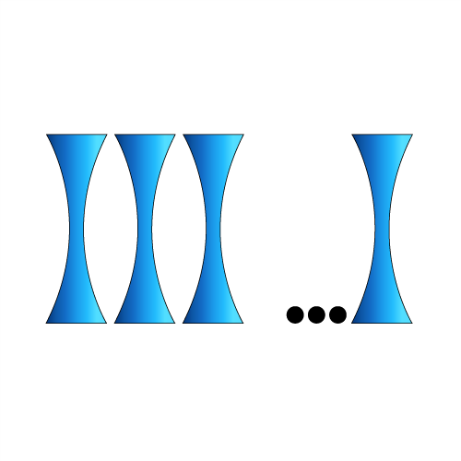






CRL (COMPOUND REFRACTIVE LENSES) = replicate N lenses
Compound Refractive Lens (CRL)
Single interface
Lens
Transfocator
1996 Experimental demonstration of CRL
A. Snigirev et al Nature 384 (1996) 49
2011 Transfocator

Slide 19

Beamline ISN

Slide 20




Surface Errors: DABAM
Direct link
Common format
ShadowOui Widget
SRW Widget
SYNED Widget

Slide 21


Surface Errors
Height Profile Simulator Pre-DABAM

